Slide 1
Code First Girls Introduction to Data and SQL
Final Project By Olufunmi Alayande

Slide 2
Employee Payroll Management System (EPMS)

Slide 3
Table of Contents
Cover Page Page 1
Title Page Page 2
Table of Contents Page 3
Introduction Page 4
Project Brief Pages 5-9
Codes and Tables Pages 10-19
Schema Page 20
Concepts Pages 21-23
End Page 24

Slide 4
Introduction
As a Finance professional, I have a strong understanding of the importance of streamlined payroll processes.
The choice of this project stems from a profound understanding of the multifaceted challenges faced by finance professionals in ensuring accurate, timely, and compliant payroll processing. It leverages on technology, automation and data analytics to enhance accuracy, remove manual errors and provide a secure way of managing sensitive financial information.

Slide 5
Project Brief
Employee Information
This is a fundamental component of the payroll management system. It stores the key data of each employee within the organization. The following fields are presented in the employee table; Employee ID, First Name, Last Name, Hire Date, City and State.

Slide 6
Project Brief Cont’d
2. Salary Information
This is a crucial table in the EPMS as it plays a central role in accurately calculating, managing, and tracking employee compensation. The fields in the salary information table are; Salary ID, Gross Salary, Hourly Pay, Income Tax, NI, Account ID.

Slide 7
Project Brief Cont’d
3. Department Information
It serves as a foundational component that organizes and manages information relating to the different departments within the organization. Its fields are; Department ID and Department Name .

Slide 8
Project Brief Cont’d
4. Account Details
This table stores and manages the financial information related to employee bank accounts. Its importance lies in its ability to ensure secure and accurate salary disbursements while also supporting various financial transactions within the organization. The fields in this tables are; Account ID, Bank Name, Account Number, Employee ID.

Slide 9
Project Brief Cont’d
Work Location
This table provides a structured framework for managing and organizing information related to the geographical work locations of employees. It contributes to accurate payroll processing, compliance with tax regulations, and efficient management of workforce-related logistics. The table has the following; Location ID, Location, Employee ID, City and State.

Slide 10
Codes and Tables

Slide 11
Employee Table
Create table EPMS.Employee(
Employee_ID VARCHAR(50) NOT NULL,
First_Name VARCHAR(25) NOT NULL,
Last_Name VARCHAR(25) NOT NULL,
Hire_Date DATE NOT NULL,
City VARCHAR(25) NOT NULL,
State VARCHAR(25),
CONSTRAINT EMPLOYEE_PK PRIMARY KEY (Employee_ID));

Slide 12
Populate Employee Table
INSERT INTO EPMS.Employee (Employee_ID,First_Name,Last_Name,Hire_Date,City,State)
VALUES
('E001','John','Doe','2023-01-15',’New York','NY’),
('E002','Alice','Smith','2022-05-20','San Francisco','CA’),
('E003','James','Johnson','2022-09-08','Chicago','IL’),
('E004','Emily','Brown','2023-03-12','Los Angeles','CA’),
('E005','Michael','Davis','2022-11-02','Houston','TX’),
('E006','Sophia','Wilson','2023-02-28','Seattle','WA’),
('E007','William','Miller','2022-07-14','Boston','MA’),
('E008','Olivia','Jones','2022-12-10','Atlanta','GA’),
('E009','Benjamin','Taylor','2022-04-05','Denver','CO’),
('E010','Ava','Martinez','2023-06-18','Miami','FL');

Slide 13
Department Table
CREATE TABLE EPMS.Department(
Dept_ID VARCHAR(25) NOT NULL,
Dept_Name VARCHAR(25) NOT NULL,
CONSTRAINT DEPARTMENT_PK PRIMARY KEY (Dept_ID));
* Department Table was populated using the Table Data Import Wizard.

Slide 14
Account Details Table
CREATE TABLE EPMS.AccountDetails(
Account_ID VARCHAR(50) NOT NULL,
Bank_Name VARCHAR(50) NOT NULL,
Account_Number VARCHAR(50) NOT NULL,
Employee_ID VARCHAR(50) NOT NULL,
CONSTRAINT Account_PK PRIMARY KEY (Account_ID),
FOREIGN KEY (Employee_ID)
REFERENCES Employee(Employee_ID));

Slide 15
Populate Account Details Table
INSERT INTO EPMS.AccountDetails (Account_ID,Bank_Name,Account_Number,Employee_ID)
VALUES
('A001','Bank of XYZ',1234567890,'E001’),
('A002','National Bank',9876543210,'E002’),
('A003','FinanceCorp','5678901234','E003’),
('A004','City Savings',4567890123,'E004’),
('A005','Metro Bank',3456789012,'E005’),
('A006','Capital One',7890123456,'E006’),
('A007','United Trustee',6543210987,'E007’),
('A008','Prosper Bank',8901234567,'E008’),
('A009','Harmony Finance',2345678901,'E009’),
('A010','Liberty Savings',6789012345,'E010');

Slide 16
Salary Table
CREATE TABLE EPMS.Salary(
Salary_ID VARCHAR(10) NOT NULL,
Gross_Salary DECIMAL(10, 2) NOT NULL,
Hourly_Pay DECIMAL(10, 2) NOT NULL,
Income_Tax DECIMAL(10, 2) NOT NULL,
NI DECIMAL(10, 2) NOT NULL,
Account_ID VARCHAR(50) NOT NULL,
CONSTRAINT SALARY_PK PRIMARY KEY (Salary_ID),
FOREIGN KEY (Account_ID)
REFERENCES AccountDetails(Account_ID));

Slide 17
Populate Salary Table
INSERT INTO EPMS.Salary
(Salary_ID,Gross_Salary,Hourly_Pay,Income_Tax,NI,Account_ID)
VALUES
('S001',60000.00,30.00,15000.00,5000.00,'A001’),
('S002',70000.00,35.00,17500.00,5500.00,'A002’),
('S003',55000.00,27.00,13750.00,4500.00,'A003’),
('S004',50000.00,25.00,12500.00,4000.00,'A004’),
('S005',65000.00,32.00,16250.00,4800.00,'A005’),
('S006',60000.00,30.00,15000.00,5000.00,'A006’),
('S007',70000.00,35.00,17500.00,5500.00,'A007’),
('S008',75000.00,37.00,18750.00,6000.00,'A008’),
('S009',52000.00,26.00,13000.00,4200.00,'A009’),
('S010',58000.00,29.00,14500.00,4600.00,'A010');

Slide 18
Work Location Table
CREATE TABLE EPMS.Work_Location(
Location_ID VARCHAR(10) NOT NULL,
Location VARCHAR(25) NOT NULL,
Employee_ID VARCHAR(50) NOT NULL,
City VARCHAR(25) NOT NULL,
State VARCHAR(25) NOT NULL,
CONSTRAINT Loc_PK PRIMARY KEY (Location_ID),
FOREIGN KEY (Employee_ID)
REFERENCES Employee(Employee_ID));

Slide 19
Populate Work Location Table
INSERT INTO EPMS.Work_Location
(Location_ID,Location,Employee_ID,City,State)
VALUES
('L001','Main Office','E001','New York','NY’),
('L002','Tech Park','E002','San Francisco','CA’),
('L003','Financial Center','E003','Chicago','IL’),
('L004','Marketing Hub','E004','Los Angeles','CA’),
('L005','Operations Center','E005','Houston','TX’),
('L006','Development Lab','E006','Seattle','WA’),
('L007','Sales Branch','E007','Boston','MA’),
('L008','Customer Service Hub','E008','Atlanta','GA’),
('L009','Legal Office','E009','Denver','CO’),
('L010','Admin Center','E010','Miami','FL');

Slide 20
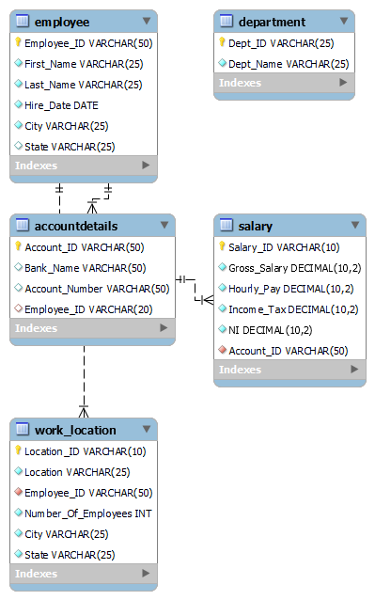
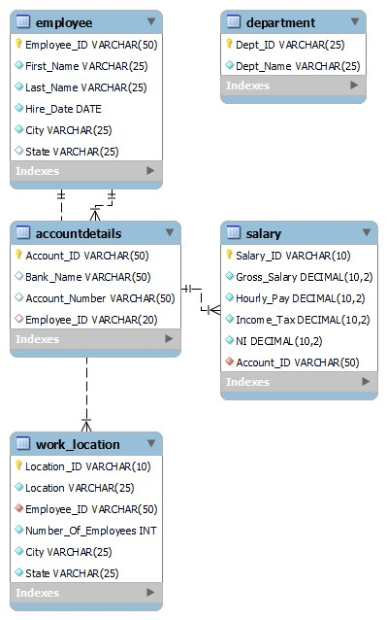
SCHEMA

Slide 21
Concepts

Slide 22
Create a Stored Procedure to add new employees to Employee table
USE EPMS;
##Change Delimiter
DELIMITER //
## CREATE STORED PROCEDURE
CREATE PROCEDURE add_new_employee (
IN Employee_ID VARCHAR(50),
IN First_Name VARCHAR(25),
IN Last_Name VARCHAR(25),
IN Hire_Date DATE,
IN City VARCHAR(25),
IN State VARCHAR(2)
)
BEGIN
INSERT INTO Employee(Employee_ID, First_Name, Last_Name, Hire_Date, City, State)
VALUES (Employee_ID, First_Name, Last_Name, Hire_Date, City, State);
END//
## Change Delimiter again
DELIMITER ;

Slide 23
Sample Query to identify salaries with an average gross salary of 60000.00 or more
SELECT Salary_ID, AVG(Gross_Salary) AS Average_Gross_Salary
FROM Salary
GROUP BY Salary_ID
HAVING AVG(Gross_Salary) > 60000;

Slide 24
THE END

Slide 25
Thank you
Olufunmi Alayande​
olufunmiabode@gmail.com
https://www.linkedin.com/in/olufunmi-alayande-997906b2/

